Slide 1
Christmas project
The TMT sector: Big Data
Eloi Bribian
Ákos Érsek
Iker Caballero
Carlos Luna
Tomás Blasco
Dani González

Slide 2
TMT SECTOR - BIG DATA
The global big data technology market was valued at $36.8 billion in 2018 and is expected to reach $104.3 billion by 2026
Drivers of this market: IoT, IaaS & AI
Expansion of blockchain technology, lower data storage costs, enormous data generation and e-commerce companies are expected to drive the global market
Cloud computing solutions are likely to pave the way for new market opportunities since they eliminate the need of hardware

Slide 3


Hedging strategy
3262.83€ millions
Enterprise Value
3675.25€ millions
2922.29€ millions
Equity Value
2664.55€ millions

Slide 4


Business strategy
Notes:
-Común
-Empleados
-Restructuración

Slide 5
Financial analysis
1.62x
Liquidity
1.27x
1.54
Financial Leverage
6.03
35.11%
Debt
83.43%
-24.94%
ROA (%)
0.68%
-41.24%
ROE (%)
3.15%
TTM
TTM

Slide 6
Financial analysis
34.27€ millions
Operating Cash Flow
200€ millions
61.96€ millions
Investment Cash Flow
- 110€ millions
- 6.10€ millions
Financial Cash Flow
- 320€ millions
2019
TTM

Slide 7
Financial analysis
431.95€ millions
Revenue
1791€ millions
30.61%
Revenue Growth
-7.9%
49.6%
Gross Profit Growth
-3%
70%
Gross Profit
50%
-49.8%
Operating Margin
1.9%
TTM
TTM

Slide 8
Multiple analysis
7.6x
Ent. Val. / Revenue
2.1x
NM
Ent. Val. / EBITDA
21.5x
NM
EBITDA / Eq. Value Multiple
15.6x
2.34x
Price to Book
9.09x

Slide 9




BIG DATA - COMPETITION

Slide 10
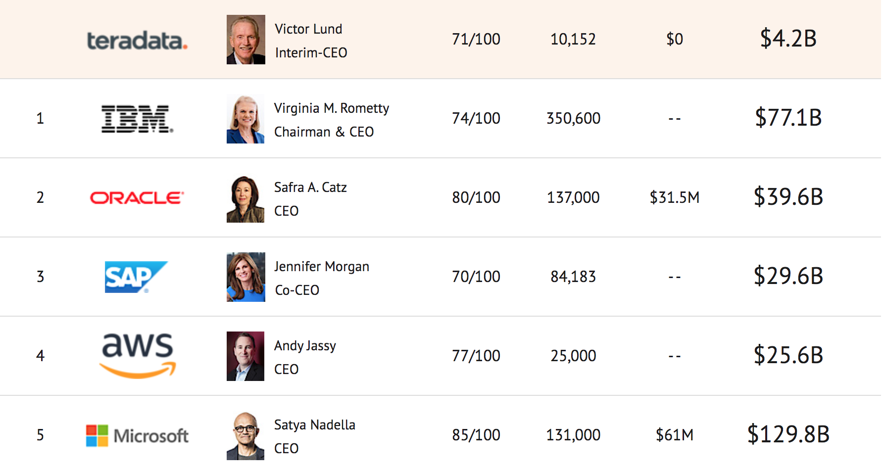
Competitive scene of DATA WAREHOUSING
The global data warehousing market size was valued at $18.61 billion in 2017, growing at a CAGR of 8.2% from 2018 to 2025.
BFSI and Telcos are likely to drive demand the most in the coming years Terradata works with the top 17 telecommunication companies and 17 of the top 20 BSFIs
Data Warehousing is expensive: hinders entry, but also growth as SME have limited budgets
Terradata is transitioning towards subscriptions
IBM and Oracle

Slide 11
Insider Transactions
¿What do the people that knows more about these firms with THEIR money?
INSIDER MODEL 48
INSIDER MODEL 87

Slide 12
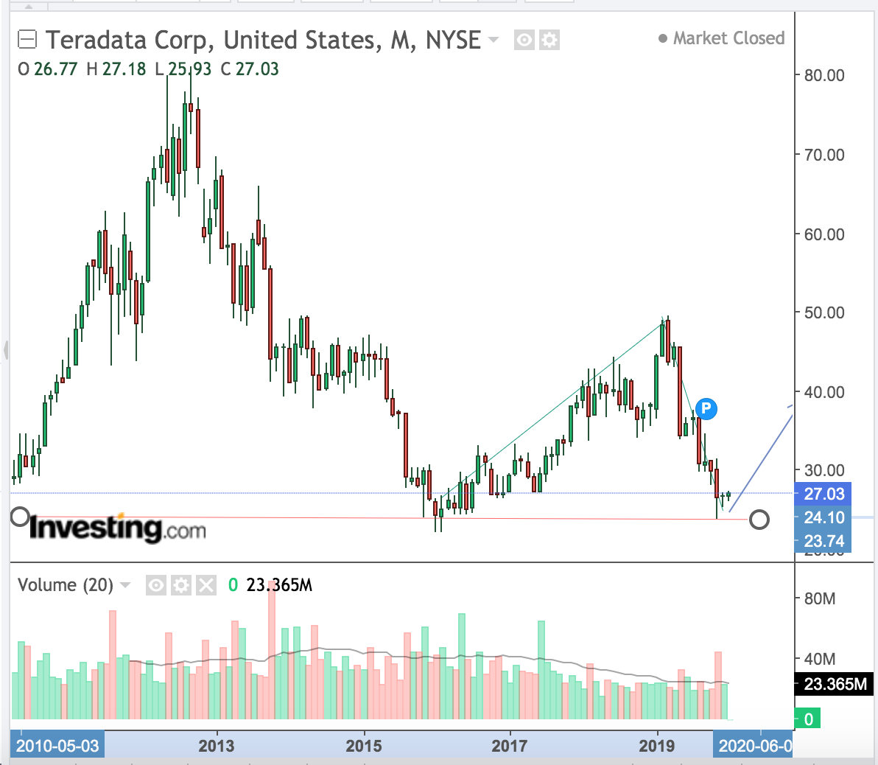
Análisis técnico

Slide 13
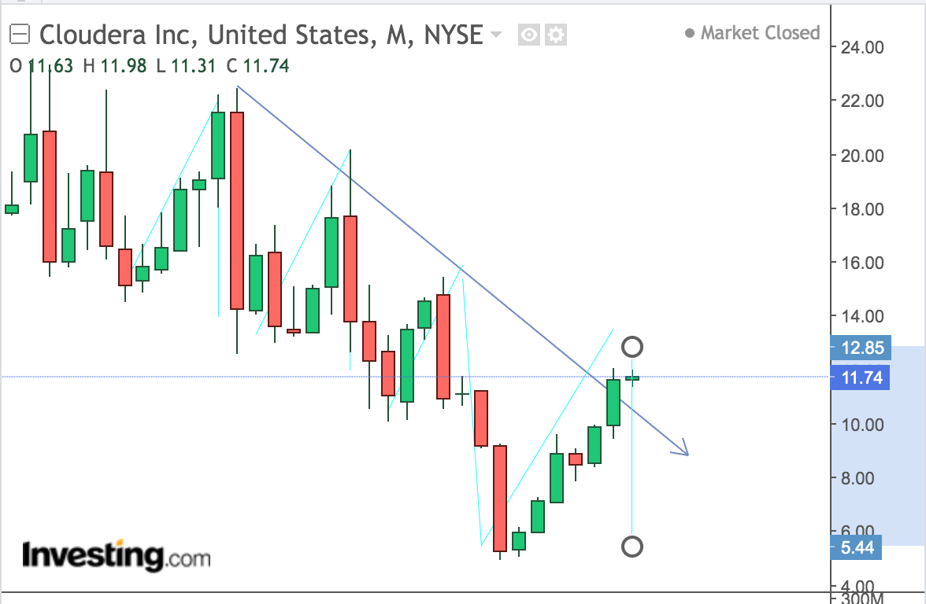
Análisis técnico

Slide 14
The End

